Slide 1
Udacity Connect Session
April 7, 2018
Unsupervised Learning
- Feature Selection
- Feature Transformation (PCA)
github.com/zkhundkar/ConnectIntensive/06..

Slide 2
Welcome back!

Slide 3
Morning Schedule
10:00 - 10:30 | Housekeeping, Review
10:30 - 11:00 | Other Clustering Algorithms
11:00 - 11:45 | Notebook Session
11:45 - noon | Notebook Review
© 2016 Udacity. All rights reserved.

Slide 4
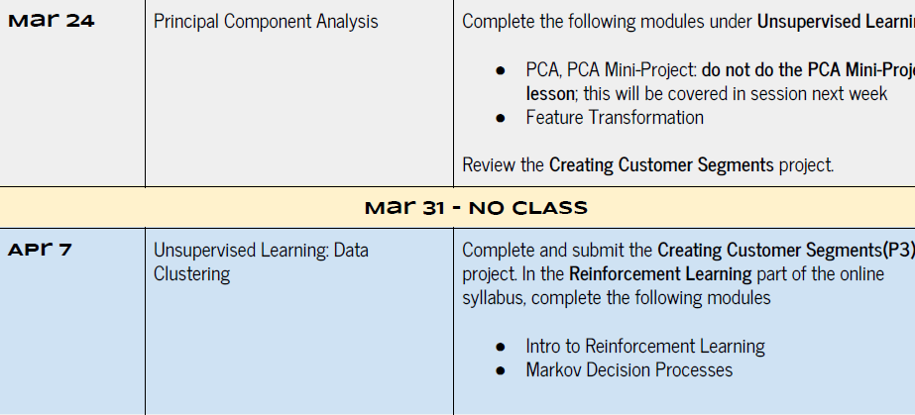

Slide 5
Review
CLUSTERING REVIEW
System gets unlabeled data and tries to group (cluster) them in some way - Similar vs. dissimilar (distance)
- Goal is to discover hidden “structure”
- “Hard” vs. “soft” clusters
© 2016 Udacity. All rights reserved.

Slide 6
Clustering Algorithms
Centroid-based - K-means (KNN)
Heirarchical Agglomerative Clustering (SLC, ALC, CLC, Ward)
Density-based - DBSCAN
Gaussian Mixed Models (GMM)

Slide 7
K-Means Clustering
Advantages
Easy to understand and implement
General-purpose
Fast
Handles large samples well (parallelizable)
Disadvantages Have to “guess” N Clusters could depend on initial guess (not consistent) Hard clusters - one point is assigned to one cluster

Slide 8
Hierarchical Agglomerative Clustering
Start with all points as separate clusters
Merge “nearest” points or clusters into one
Repeat until we have merged all points
Select a “cutoff” height to choose the number of clusters

Slide 9

HAC - Linkage Criteria
Name | Distance metric
Single-Link Clustering | Min { d(a,b) : a 𝜖 A, b 𝜖 B }
Complete-Link Clustering | Max { d(a,b) : a 𝜖 A, b 𝜖 B }
Average-Link Clustering | Mean { d(a,b) : a 𝜖 A, b 𝜖 B }
Ward minimal variance

Slide 10
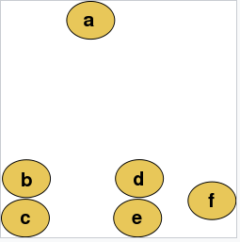
Single-Linkage Clustering
a
b
c
d
e
f

Slide 11
HAC - Advantages
Hierarchical representation contains richer information
Dendrogram provides good visualization of cluster relationships
Consistent - “always” results in the same clusters

Slide 12
HAC - Disadvantages
Sensitive to noise (outliers)
Computationally intensive
Sensitive to metric and linkage criterion

Slide 13
DBSCAN Clustering
DENSTY-BASED SPATIAL CLUSTERING OF APPLICATIONS WITH NOISE
Start with arguments ε and minPts
Select a point and find its neighbors (ε)
If count of neighbors < minPts mark as outlier
Otherwise, mark point as core point and all neighbors as border points
Examine all neighbors (repeat from step 3)
A core point and all other points reachable from it form a cluster

Slide 14
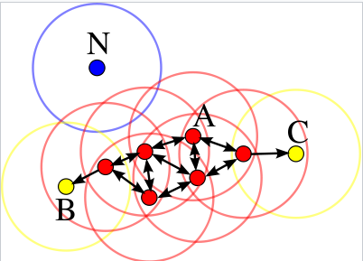
DBSCAN
minPts = 4

Slide 15
DBSCAN Clustering - Advantages
ADVANTAGES
Does not require a priori knowledge of the number of clusters
Can find arbitrarily shaped clusters.
Robust to outliers or noise
Requires just two parameters ( ε neighborhood size and minimum cluster size)
Mostly insensitive to the ordering of the points in the dataset

Slide 16
DBSCAN Clustering
DISADVANTAGES
Clusters can depend on the order points are processed
Depends on distance measure.
Cannot properly cluster datasets with large differences in densities
Need domain knowledge to pick ε and min pts

Slide 17
Gaussian Mixed Models
SOFT CLUSTERS
Assume samples are derived from one or more overlapping normal distributions
“Derived” implies randomly selected from iid gaussians
Deduce the parameters of the underlying distributions

Slide 18
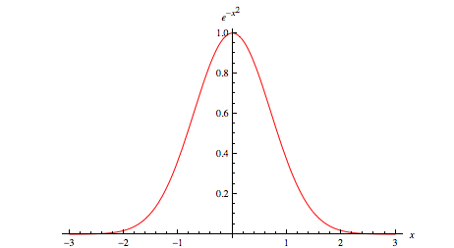
Gaussian Function in 1-D
STANDARD NORMAL DISTRIBUTION
g(x) = (1/√(2𝝅𝜎²)) exp(-(x-𝜇)²/2𝜎²)

Slide 19
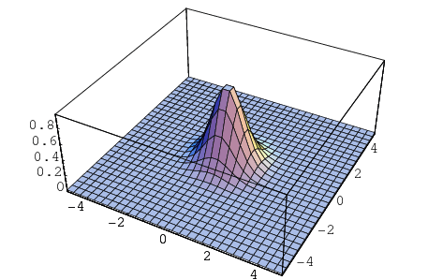
Gaussian in 2 dimensions

Slide 20
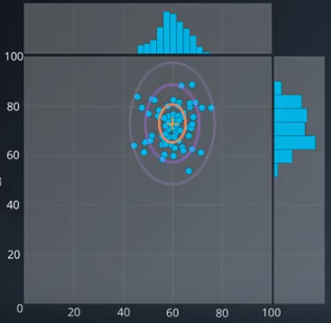

Slide 21
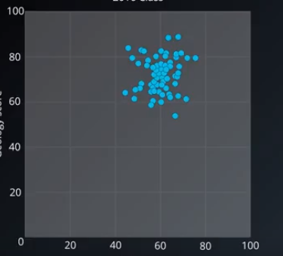
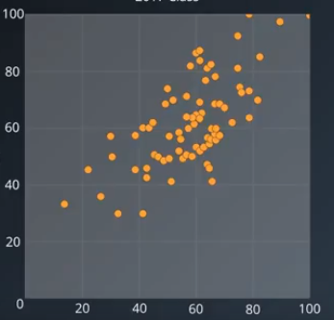
GMMs in 2-D

Slide 22
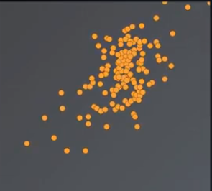
GMM - Observations

Slide 23
GMM - Expectation Maximization
Initialize (guess) the k Gaussian distributions
Calculate soft-cluster assignment probabilities
Re-estimate the k Gausssians (make a better guess)
Evaluate log-likelihood for model (check for convergence)
Iterate from step 2 until no meaningful change in log likelihood

Slide 24
GMM - Soft cluster expectation
E[Z_{i,A}] = N_{A}(X|𝞵_{A}, 𝜎_{A}²) / (N_{A}(X|𝞵_{A}, 𝜎_{A}² ) + N_{B}(X|𝞵_{B}, 𝜎_{B}²))
E[Z_{i,B}] = N_{B}(X|𝞵_{B}, 𝜎_{B}²) / (N_{A}(X|𝞵_{A}, 𝜎_{A}² ) + N_{B}(X|𝞵_{B}, 𝜎_{B}²))

Slide 25
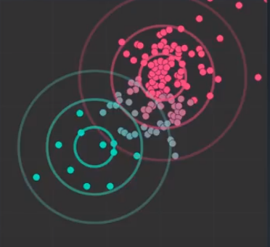
Re-estimate Gaussians
𝞵_{A}^{(new)} = 𝝨 E[Z_{i,A}]X_{i} / 𝝨 E[Z_{i,A}]
𝜎_{A}^{2 (new)} = 𝝨 E[Z_{i,A}](X_{i} - 𝞵_{A})² / 𝝨 E[Z_{i,A}]

Slide 26
GMM Clustering - Advantages
GAUSSIAN MIXED MODEL
Soft clustering (only one of the ones we discussed)
Can handle clusters of different geometries

Slide 27
GMM Clustering - Disadvantages
GAUSSIAN MIXED MODEL
Have to “guess” N
Clusters could depend on initial guess (not consistent)
Could converge to a local minimum
Convergane can be slow

Slide 28
github.com/zkhundkar/ConnectIntensive/
07a Clustering HAC, DBSCAN and GMM
conda install -n mlnd scipy

Slide 29
Lunch Break

Slide 30
Afternoon Session
1:00 - 1:30 | Feature Selection/Transformation
1:30 - 2:00 | Principal Component Analysis
2:00 - 2:45 | PCA mini-project (notebook)
2:45 - 3:00 | Recap, Lookahead and Feedback
3:00 - 5:00 | P3 review and work on P3
© 2016 Udacity. All rights reserved.

Slide 31
Feature Selection
Interpretability - explain our results
Curse of dimensionality
# samples needed grows exponentially with number of dimensions
Essential compromise
<100% Explained variance

Slide 32
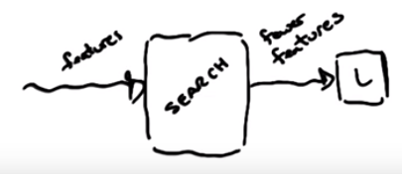
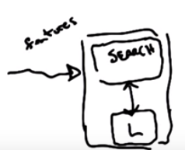
Feature Selection
Goal - pick best subset of features
- Filtering
Can be fast
Look at features in isolation
No reference to learner
- Wrapping
Slow
Uses feedback from learner

Slide 33
Feature Selection
Filtering
External criteria for selection
Information Gain, Entropy, “usefulness”, independence
Wrapping
Hill-climbing/Randomized optimization
Forward Search/Backwards search

Slide 34
Usefulness vs Relevance
Relevance => formal
Bayesian Optimal Learner (not a specific model)
Usefulness => practical
Error for a given model (classifier)

Slide 35
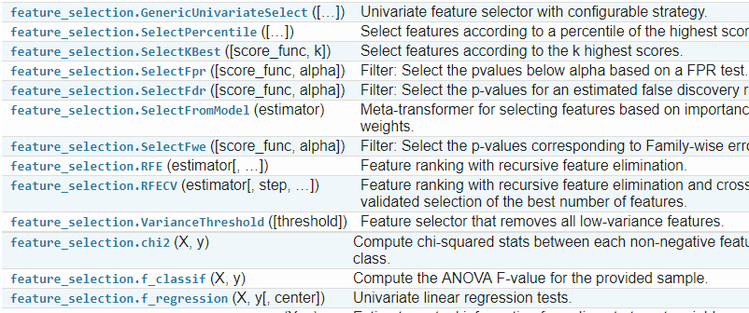
Feature Selectors
module-sklearn.feature_selection

Slide 36
Feature Transformation
Observable variables
Measurable, not necessarily knowledge
Latent (hidden) variables
Not measurable, true influencer

Slide 37
Linear Transformations
Estimate the hidden variables
Linear combinations of measurable variables
PCA - Principal Components Analysis | variance
ICA - Independent Components Analysis | independence

Slide 38
Transformation and Selection
How does this help with choosing a model?
Need fewer features if they are the latent variables
Find it an equally good fit with simpler model
More generalizable?

Slide 39
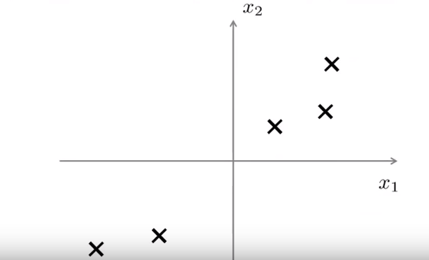
Principal Component Analysis
PCA - https://www.youtube.com/watch?v=T-B8muDvzu0
O
oo
o
O O O O O

Slide 40
github.com/zkhundkar/ConnectIntensive/
07b PCA miniproject

Slide 41
Prep for next week
Submit Customer segments Project (P3) this week!!
Reinforcement Learning - Lessons 1 - 3

Slide 42
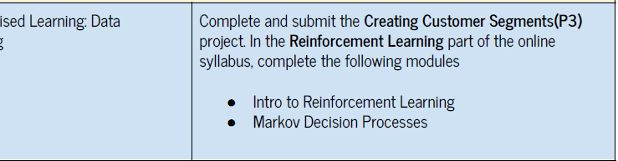
Reinforcement Learning

Slide 43

We really need your Feedback!
© 2016 Udacity. All rights reserved.

